Slide 1

Becoming a Pusher Reactive Framework
Jim Wooley
www.ThinqLinq.com
Twitter: @JimWooley

Slide 2
Reactive Framework
“RX is a library for composing asynchronous and event-based programs using observable collections.”

Slide 3
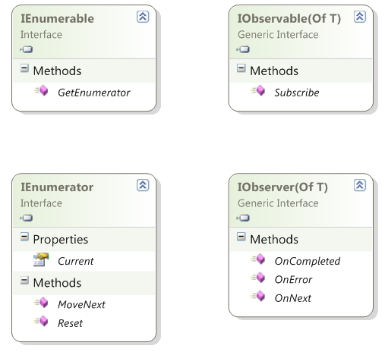
IEnumerable vs. IObservable

Slide 4
Pull vs Push
From candy in bagOfCandies
Where candy.HasNuts
Group candy By Key = candy.Name into GroupedCandies
Select new {Key, CandyCount = GroupedCandies.Count}

Slide 5
Demo
Using the Reactive Framework

Slide 6
Subscription Pipeline
var query = observable.Select(f); //build
var sub = query.Subscribe(handler); // subscribe
… handler.OnNext // receive
… handler.OnNext // data
… handler.OnNext
sub.Dispose(); // unsubscribe

Slide 7
IObservable.Subscribe
Observable.Subscribe(
Action<bool> onNext,
Action<Exception> onError,
Action onCompleted);

Slide 8
Merge

Slide 9
Zip

Slide 10
Repeat

Slide 11
IO<T> Until(IO<T> source, IO<U> until)
IO<T>
IO<U>
IO<T>

Slide 12
Additional LINQ operators
Amb
Asynchronous
BufferWithCount
Catch
Concat
Defer
Delay
Do
Generate
Merge
OnErrorResumeNext
Repeat
Retry
Run
StartWith
Timeout

Slide 13
When to use Reactive Framework
Continuous Events / Streams
Sensors
Asynchronous operations
UI Events

Slide 14
Resources
Rx center on Dev Labs http://msdn.microsoft.com/en-us/devlabs/ee794896.aspx
Rx Forum http://social.msdn.microsoft.com/Forums/en-US/rx/threads
RxWiki (Samples and more) http://rxwiki.wikidot.com

Slide 15
Questions
Jim Wooley
www.ThinqLinq.com
@LinqKinq

